Slide 1
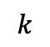
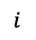


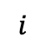

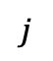

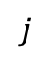
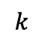
$$j$$
$$j$$
$$i$$
$$i$$
$$=$$
$$k$$
$$k$$
$$=$$
$$+$$
$$…$$

Slide 2



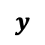
$$≈$$
$$w$$
$$X$$
$$y$$

Slide 3


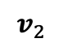
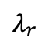

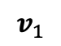
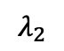
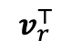
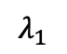
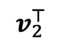
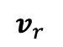
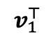
$$λ_{1}$$
$$v_{1}^{⊤}$$
$$λ_{2}$$
$$v_{2}^{⊤}$$
$$v_{1}$$
$$v_{2}$$
$$v_{r}$$
$$…$$
$$…$$
$$…$$
$$λ_{r}$$
$$v_{r}^{⊤}$$

Slide 4



$$A$$
$$C$$
$$B$$

Slide 5
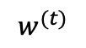

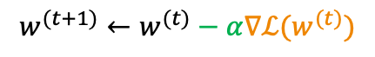
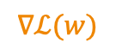
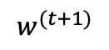
$$w^{(t+1)}←w^{(t)}−α∇ℒ(w^{(t)})$$
$$∇ℒ(w)$$
Loss
Parameter
$$w^{∗}$$
$$w^{(t+1)}$$
$$w^{(t)}$$

Slide 6
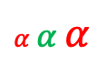
Loss
$α$ $α$ $α$
Parameter
$$w^{∗}$$

Slide 7



$$⋮$$
$$⋮$$
$$⋮$$
Linear Model
Neural Network

Slide 8
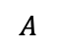
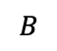
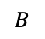
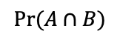
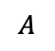
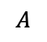
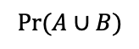
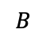
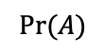
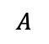
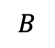
$$A$$
$$B$$
$$A$$
$$B$$
$$Pr⁡(A)$$
$$A$$
$$B$$
$$A$$
$$B$$
$$Pr⁡(A∪B)$$
$$Pr⁡(A∩B)$$

Slide 9
Label 0
Label 1
TPR =
False Positive
True Positive
FPR =
Precision =
True Negative
False Negative

Slide 10
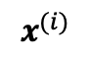
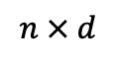

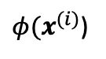
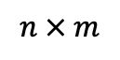
$$x^{(i)}$$
${φ(x}^{(i)}$)
$$⇒$$
$$n × d$$
$$n × m$$

Slide 11
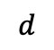
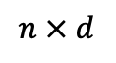
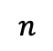
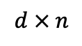
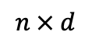
vs.
$$n × d$$
$$d$$
$$n × d$$
$$d × n$$
$$n$$

Slide 12
$$⋮$$
$$⋮$$
$$⋮$$
Linear Model
Neural Network

Slide 16







$$x$$
$$u_{1}$$
$$ℒ$$
$$u_{2}$$
$$v$$
$$⋮$$
$$u_{d}$$

Slide 17
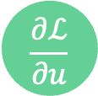
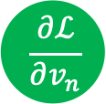

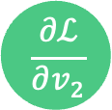
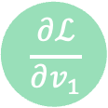

$$\frac{∂ℒ}{∂v_{1}}$$
$$\frac{∂ℒ}{∂u}$$
$$\frac{∂ℒ}{∂v_{2}}$$
$$\frac{∂ℒ}{∂ℒ}$$
$$⋮$$
$$\frac{∂ℒ}{∂v_{n}}$$

Slide 18
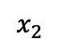
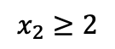
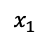
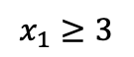


$$x_{1}≥3$$
$$x_{2}$$
$$2$$
$$x_{2}≥2$$
$$3$$
$$x_{1}$$

Slide 19

$$…$$

Slide 20



$$+$$
$$+$$
$$=$$

Slide 21
vs.

Slide 22
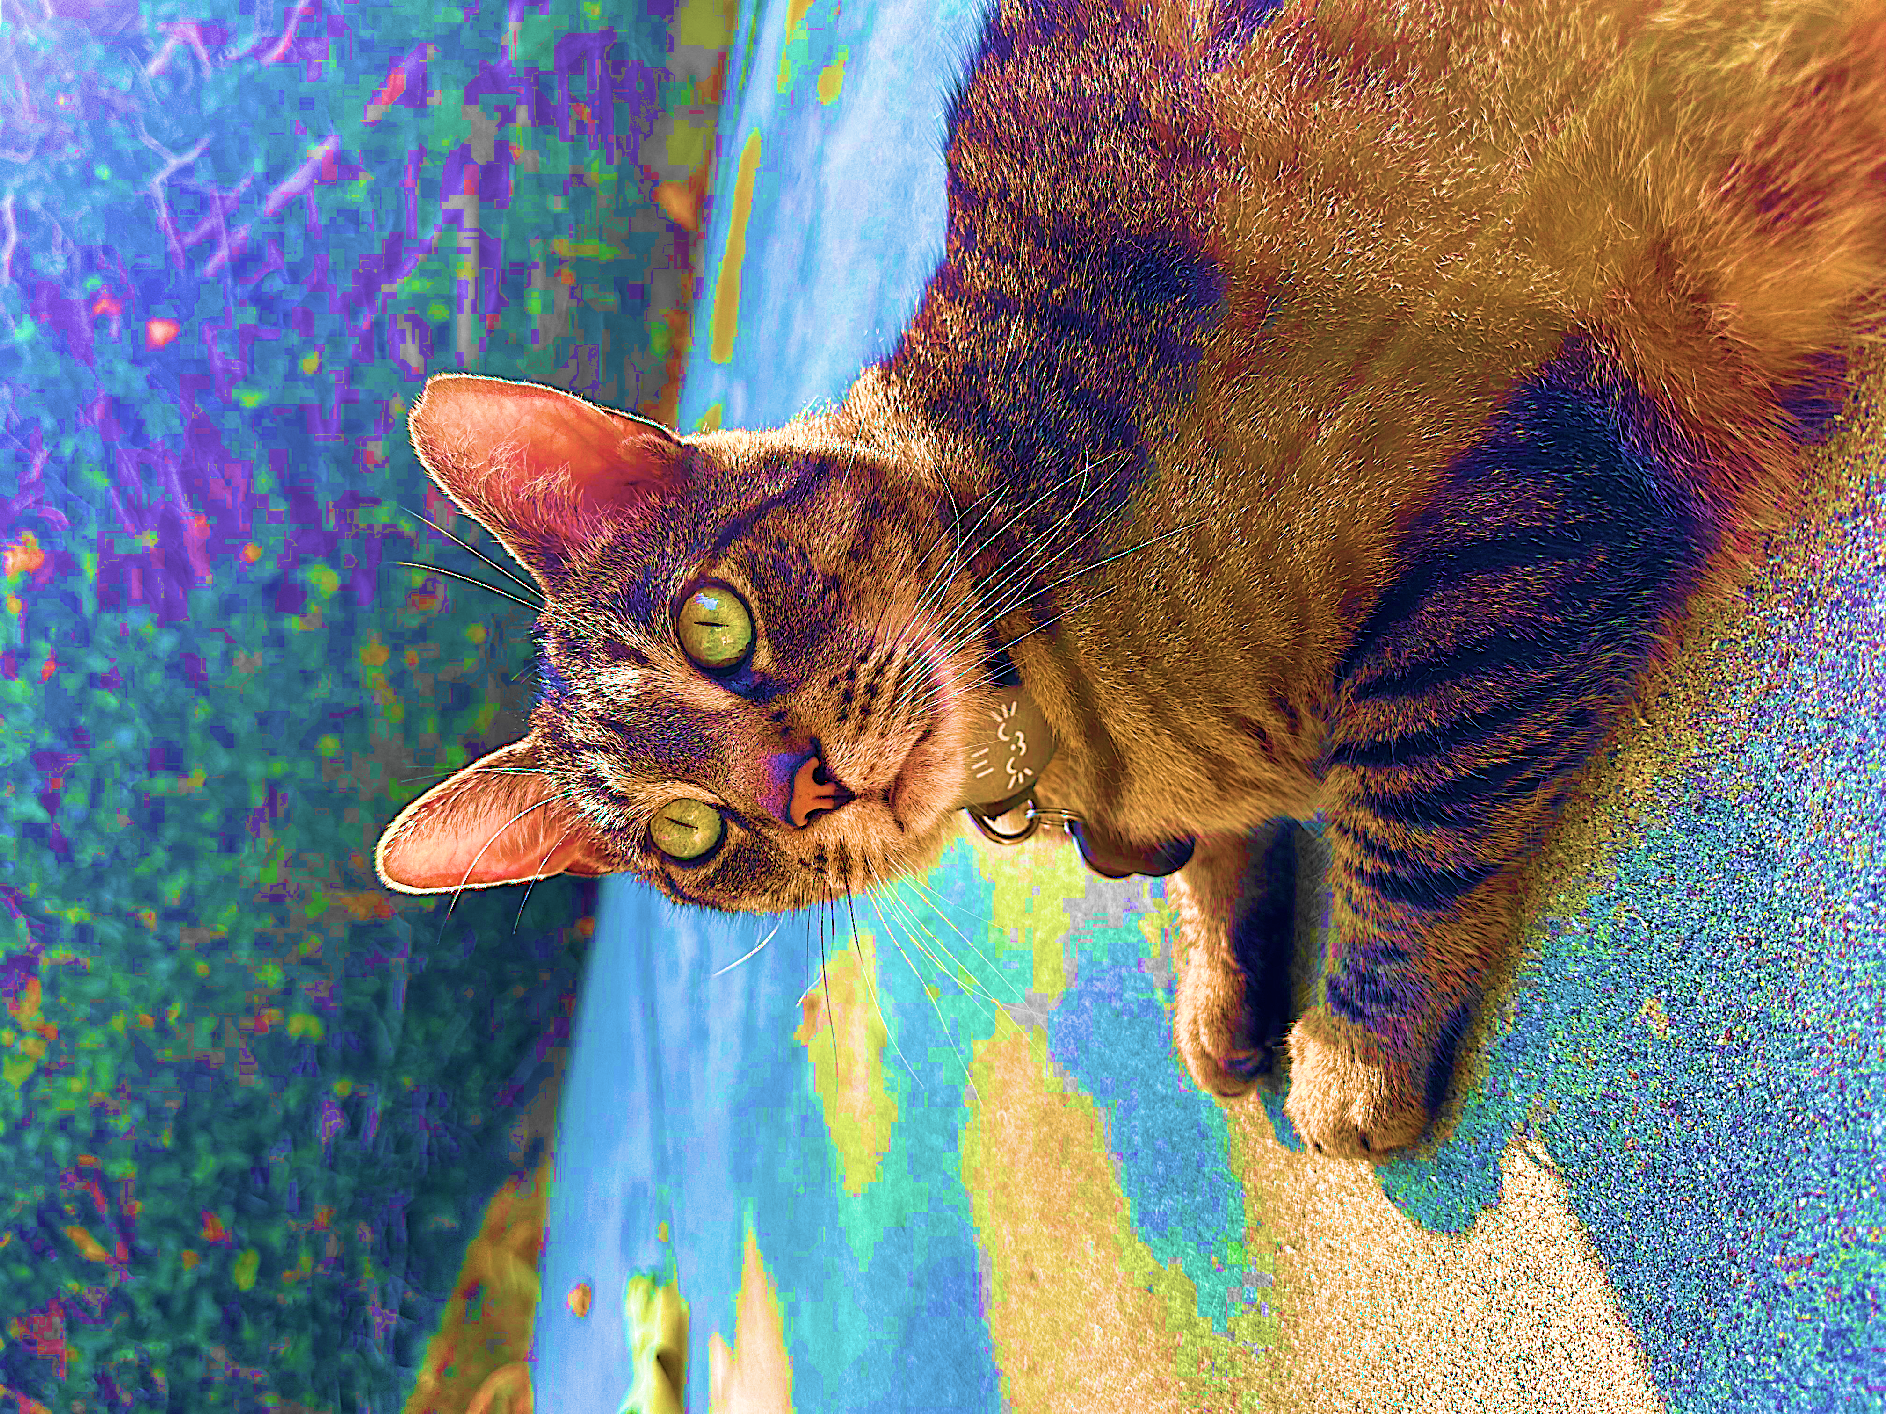


Natural Images
Autoencoder
All Images

Slide 23






$$x$$
$$μ$$
$$\tilde{x}$$
$$z$$
$$Σ$$
$$ε$$

Slide 24






$$x^{⊤}$$
$$W_{0}$$
$$W_{1}$$
$${z=x^{⊤} W}_{0}$$
$$W_{1}$$
$$=$$

Slide 25




$$X$$
$$W_{0}$$
$$W_{1}$$
$$\tilde{X}$$
$$=$$

Slide 26





$$X$$
$$U$$
$$Σ$$
$$V^{⊤}$$
$$=$$

Slide 27




$$v_{1}$$
$$v_{1}$$
$$v_{2}$$
$$v_{2}$$

Slide 28



cat
dog
kitten
puppy
great
good
…
doc₁
 |  | 1 |  |  |  |  |  | 1
1 |  |  |  |  | 1 |  | 1
 | 1 |  |  |  | 1 |  | 1
 |  | 1 |  | 1 |  |  |  |  | 1
 | 1 |  |  |  |  | 1 |  | 1
$$U_{k}Σ_{k}$$
$$V_{k}^{⊤}$$
doc₂
doc₃
$$≈$$

Slide 29


cat
dog
kitten
puppy
great
good
…
doc₁
 |  | 1 |  |  |  |  |  | 1
1 |  |  |  |  | 1 |  | 1
 | 1 |  |  |  | 1 |  | 1
 |  | 1 |  | 1 |  |  |  |  | 1
 | 1 |  |  |  |  | 1 |  | 1
$$U_{k}$$
$${Σ_{k}V}_{k}^{⊤}$$
doc₂
doc₃
$$≈$$

Slide 30
old
dog
dog
young
puppy
puppy
old
young

Slide 31
cat
said
good
trick
“I know some good games we could play,” said the cat.
“I know some new tricks,” said the Cat in the Hat.
“A lot of good tricks. I will show them to you.
Your mother will not mind at all if I do.”
cat
2 | 2 | 0 | 1
2 | 2 | 0 | 1
0 | 0 | 2 | 1
1 | 1 | 1 | 2
said
good
trick

Slide 32
English
Spanish
Japanese
cat
gato
猫

Slide 33
1
2
3
7
1
0 | 0 | 0 | 1
1 | 0 | 0 | 0
1 | 0 | 0 | 0
0 | 0 | 1 | 0
3
1
2
7
3
4
0
7
2
6

Slide 34




1 | 0 | 0 | 0
0 | 1 | 0 | 0
0 | 0 | 1 | 0
0 | 0 | 0 | 1
Stripes on the grass.
Caleb cleaning himself.
Stripes stretching out.
Caleb posing with Lego.

Slide 35






$$E_{1}$$
$$E_{2}$$
$$E_{1}$$
$$E_{2}$$
$$E_{3}$$
$$E_{3}$$

Slide 36


$$\sqrt{Var(X)}$$
$$𝔼[X]$$

Slide 37




$$0$$
$$ε⋅𝔼[X]$$
$$𝔼[X]$$

Slide 38




$$− ε\sqrt{Var(X)}$$
$$+ε\sqrt{Var(X)}$$
$$𝔼[X]$$

Slide 39




$$−ε\frac{b−a}{\sqrt{2n}}$$
$$+ε\frac{b−a}{\sqrt{2n}}$$
$$𝔼[\overline{X}]$$

Slide 40
-.53
-.42
+.65
-.07
-.04
-.17
+.15
-.80
-.36
+.93
+.76
+.91
+.84
+.78
+.93
+.87

Slide 41








$$x$$
$$f$$
$$x_{1}$$
$$x_{2}$$
$$f(x)$$
$$⋮$$
$$x_{d}$$

Slide 42




$$ν(\left\{1,2\right\})$$
$$\{2\}$$
$$\{3\}$$
$$\{1\}$$

Slide 43



$$φ_{1}$$
$$φ_{2}$$
$$φ_{3}$$
$$φ_{4}$$
$$φ_{5}$$
$$φ_{6}$$
-.5
+3
+1
-2
-1
+2
$$f(b)$$
$$f(x)$$

Slide 44








$$A$$
$$β$$
$$b$$
$$ΠA$$
$$β$$
$$Πb$$
$$≈$$
$$≈$$

Slide 45
vs.

Slide 46
High “leverage” point
Line of best fit
Sampled point
vs.
Line of best fit on samples

